Slide 1
Disorders of Respiratory System
Pathophysiology
Lecture 3
د. تماضر حامد وادي
فرع العلوم المختبرية السريرية

Slide 2
Bronchiectasis
Bronchiectasis is the permanent dilation of bronchi and bronchioles caused by destruction of the muscle and the supporting elastic tissue, resulting from or associated with chronic necrotizing infections. Once developed, it gives rise to a characteristic symptom complex dominated by cough and expectoration of copious amounts of purulent sputum. Diagnosis depends on an appropriate history along with radiographic demonstration of bronchial dilation.
Bronchiectasis usually affects the lower lobes bilaterally, particularly those air passages that are most vertical.

Slide 3
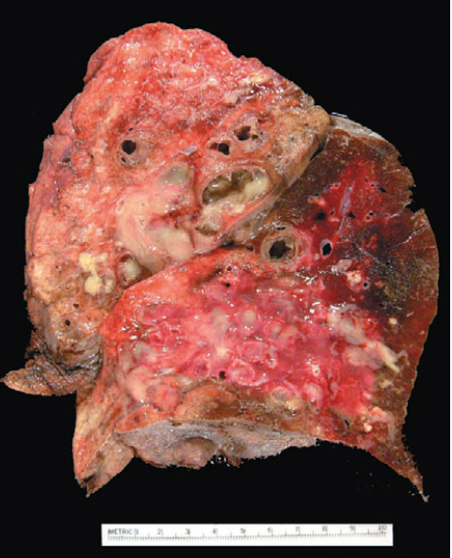
Pathogenesis of Bronchiectasis
Bronchiectasis is not a primary disease but rather secondary to persisting infection or obstruction caused by a variety of conditions.
Two processes are crucial and intertwined in the pathogenesis of bronchiectasis: obstruction and chronic persistent infection. Either of these may come first. Normal clearance mechanisms are hampered by obstruction, so secondary infection soon follows; conversely, chronic infection over time causes damage to bronchial walls, leading to weakening and dilation. For example, obstruction caused by a primary lung cancer or a foreign body impairs clearance of secretions, providing a favorable substrate for superimposed infection. The resultant inflammatory damage to the bronchial wall and the accumulating exudate further distend the airways, leading to irreversible dilation. Conversely, a persistent necrotizing inflammation in the bronchi or bronchioles may cause obstructive secretions, inflammation throughout the wall (with peribronchial fibrosis and traction on the walls).
Bronchiectasis in a patient with cystic fibrosis who underwent lung resection for transplantation. Cut surface of lung shows markedly dilated bronchi, filled with purulent mucus, which are seen extending to subpleural regions.

Slide 4
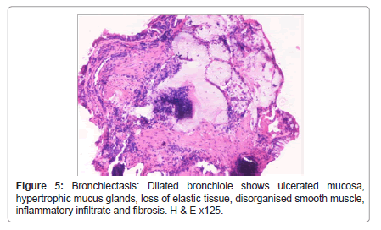
Features of Bronchiectasis
The histologic findings vary with the activity and chronicity of the disease. In the full-blown active case, an intense acute and chronic inflammatory exudate within the walls of the bronchi and bronchioles and the desquamation of lining epithelium cause extensive areas of ulceration.
When healing occurs, the lining epithelium may regenerate completely; however, usually so much injury has occurred that abnormal dilation and scarring persist. Fibrosis of the bronchial and bronchiolar walls and peribronchiolar fibrosis develop in more chronic cases.
In some instances, the necrosis destroys the bronchial or bronchiolar walls resulting in the formation of an abscess cavity within which a fungus ball may develop.

Slide 5
Pulmonary embolism
Blood clots that occlude the large pulmonary arteries are almost always embolic in origin. More than 95% of all pulmonary emboli arise from thrombi within the large deep veins of the lower legs, typically originating in the popliteal vein and larger veins above it.
There are two important consequences of embolic pulmonary arterial occlusion: (1) an increase in pulmonary artery pressure from blockage of flow and, possibly, vasospasm caused by neurogenic mechanisms and/or release of mediators (e.g., thromboxane A2, serotonin); and (2) ischemia of the downstream pulmonary parenchyma. Thus, occlusion of a major vessel results in a sudden increase in pulmonary artery pressure, diminished cardiac output, right-sided heart failure (acute cor pulmonale), or even death. Acute cor pulmonale is abnormal enlargement of the right side of the heart as a result of disease of the lungs or the pulmonary blood vessels.

Slide 6
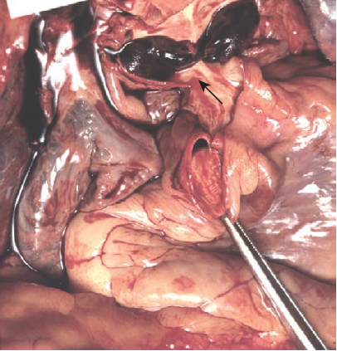
Pathological features of Pulmonary embolism
The morphologic consequences of pulmonary embolism, as noted, depend on the size of the embolic mass and the general state of the circulation. A large embolus may embed in the main pulmonary artery or its major branches or lodge astride the bifurcation as a saddle embolus. Death usually follows so suddenly from hypoxia or acute failure of the right side of the heart (acute cor pulmonale). Smaller emboli become impacted in medium-sized and small pulmonary arteries.
Pulmonary infarcts typically are hemorrhagic and appear as raised, red-blue areas in the early stages. The red cells begin to lyse within 48 hours, and the infarct pales, eventually becoming red-brown as hemosiderin is produced. In time, fibrous replacement begins at the margins as a gray-white peripheral zone and eventually converts the infarct into a scar. On histologic examination, the hallmark of fresh infarcts is coagulative necrosis of the lung parenchyma and hemorrhage.
Large saddle embolus from the femoral vein lying astride the main left and right pulmonary arteries.

Slide 7
Clinical Features of Pulmonary embolism
The clinical consequences of pulmonary thromboembolism are summarized as follows:
Most pulmonary emboli (60% to 80%) are clinically silent because they are small; the embolic mass is rapidly removed by fibrinolytic activity, and the bronchial circulation sustains the viability of the affected lung parenchyma until this is accomplished.
In 5% of cases, sudden death, acute right-sided heart failure (acute cor pulmonale), or cardiovascular collapse (shock) may occur typically when more than 60% of the total pulmonary vasculature is obstructed by a large embolus or multiple simultaneous small emboli. Massive pulmonary embolism is one of the few causes of literally instantaneous death, even before the person experiences chest pain or dyspnea.
Obstruction of relatively small to medium pulmonary branches (10% to 15% of cases) that behave as end arteries causes pulmonary infarction when some element of circulatory insufficiency is present. Typically, persons who sustain such infarction manifest dyspnea.
In a small but significant subset of patients (accounting for less than 3% of cases), recurrent multiple emboli lead to pulmonary hypertension, chronic right-sided heart strain (chronic cor pulmonale), and, in time, pulmonary vascular sclerosis with progressively worsening dyspnea.

Slide 8
Cystic fibrosis (CF)
Cystic fibrosis, which is a major cause of severe chronic respiratory disease in children and young adults, is an inherited disorder involving fluid secretion by the exocrine glands in the epithelial lining of the respiratory.
The terms ‘cystic fibrosis’ and ‘fibrocystic disease’ are preferable over ‘mucoviscidosis’ in view of the main pathologic change of fibrosis produced as a result of obstruction of the passages by viscid mucous secretions.
CF is the most common lethal genetic disease that affects white populations. It is uncommon among Asians and Africans.

Slide 9
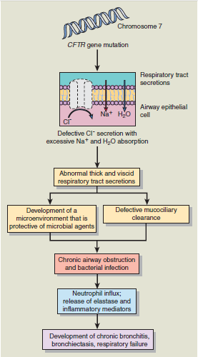
Pathogenesis of CF
Cystic fibrosis is caused by mutations in a single gene on the long arm of chromosome 7 that encodes for the cystic fibrosis transmembrane regulator (CFTR), which functions as a chloride channel in epithelial cell membranes. Mutations in the CFTR gene render the epithelial membrane relatively impermeable to the chloride (Cl) ion.
In the normal airway epithelium, Cl is secreted into airway lumen through the CFTR. The impaired transport of Cl ultimately leads to a series of secondary events, including increased absorption of Na and water from the airways into the blood. This lowers the water content of the mucociliary blanket coating the respiratory epithelium, causing it to become more viscid. The resulting dehydration of the mucous layer leads to defective mucociliary function and accumulation of viscid secretions that obstruct the airways and predispose to recurrent pulmonary infections.

Slide 10
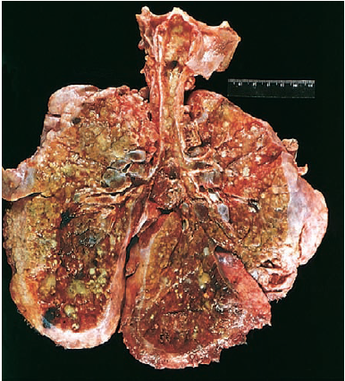
Clinical features of CF
Respiratory manifestations of CF are caused by an accumulation of viscid mucus in the bronchi, impaired mucociliary clearance, and lung infections. Chronic bronchiolitis and bronchitis are the initial lung manifestations, but after months and years, structural changes in the bronchial wall lead to bronchiectasis. In addition to airway obstruction, the basic genetic defect that occurs with CF predisposes to chronic infection with a surprisingly limited number of organisms, the most common being Pseudomonas aeruginosa, Burkholderia cepacia, Staphylococcus aureus, and Haemophilus influenzae. Soon after birth, initial infection with bacterial pathogens occurs and is associated with an excessive neutrophilic inflammatory response that appears to be independent of the infection itself. There is evidence that the airway secretions in persons with CF provide a favorable environment for harboring these organisms. P. aeruginosa, in particular, has a propensity to undergo mucoid transformation in this environment. The complex polysaccharide produced by these organisms provides a hypoxic environment and generates a biofilm that protects Pseudomonas against antimicrobial agents. Pulmonary inflammation is another cause of decline in respiratory function in persons with CF and may precede the onset of chronic infection.
Lungs of a patient who died of cystic fibrosis. Extensive mucous plugging and dilation of the tracheobronchial tree are apparent. The pulmonary parenchyma is consolidated by a combination of both secretions and pneumonia; the greenish discoloration is the product of Pseudomonas infections.

Slide 11
Pulmonary hypertension
Pulmonary hypertension is most often secondary to a decrease in the cross-sectional area of the pulmonary vascular bed, or to increased pulmonary vascular blood flow.
The causes of secondary pulmonary hypertension include:
Chronic obstructive or interstitial lung disease, which is accompanied by destruction of lung parenchyma and consequent reduction in alveolar capillaries. This causes increased pulmonary arterial resistance and secondarily, elevated arterial pressure.
Recurrent pulmonary emboli. Presence of these emboli leads to a reduction in the functional cross-sectional area of the pulmonary vascular bed, leading in turn to increased vascular resistance.
Antecedent heart disease, for example, mitral stenosis, which increases left atrial pressure, leading to higher pulmonary venous pressures, and ultimately pulmonary arterial hypertension. Congenital left-to-right shunts of blood flow are another cause of secondary pulmonary hypertension.

Slide 12
Pathogenesis of Pulmonary hypertension
According to current thinking, pulmonary endothelial cell and/or vascular smooth muscle dysfunction is the probable underlying basis for most forms of pulmonary hypertension.
In states of secondary pulmonary hypertension, endothelial cell dysfunction arises as a consequence of the underlying disorder (e.g., shear and mechanical injury due to increased blood flow in left-to-right shunts, or biochemical injury produced by fibrin in recurrent thromboembolism). Endothelial cell dysfunction reduces production of vasodilatory agents (e.g., nitric oxide, prostacyclin) while increasing synthesis of vasoconstrictive mediators like endothelin. In addition, there is production of growth factors and cytokines that induce the migration and replication of vascular smooth muscle and elaboration of extracellular matrix.
In primary pulmonary hypertension, especially in the uncommon familial form, the TGF-β signaling pathway has emerged as a key mediator of endothelial and smooth muscle dysfunction. Specifically, germline mutations of bone morphogenetic protein receptor type 2 (BMPR-2), a cell surface molecule that binds to a variety of TGF-β pathway ligands, have been demonstrated in 50% of familial cases. The BMPR2 gene product is inhibitory in its effects on proliferation; hence, loss-of function mutations of this gene result in abnormal vascular endothelial and pulmonary smooth muscle proliferation. However, not all persons with germline mutations of BMPR2 develop primary pulmonary hypertension, suggesting the existence of modifier genes that probably affect penetrance of this particular phenotype.
Studies on sporadic forms of primary pulmonary hypertension point to a possible role for the serotonin transporter gene (5HTT). Specifically, pulmonary smooth muscle cells from some patients with primary pulmonary hypertension demonstrate increased proliferation on exposure to serotonin or serum. Genetic polymorphisms of 5HTT that lead to enhanced expression of the transporter protein on vascular smooth muscle are postulated to cause their proliferation.

Slide 13
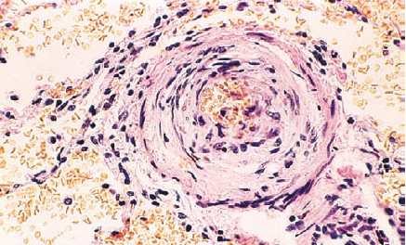
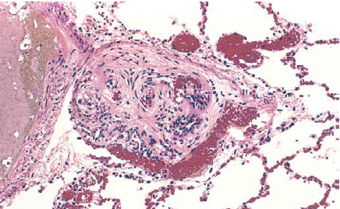
Pathological features of Pulmonary hypertension
Vascular alterations in all forms of pulmonary hypertension (primary and secondary) involve the entire arterial tree and include
in the main elastic arteries, atheromas similar to those in systemic atherosclerosis.
in medium-sized muscular arteries, proliferation of myointimal cells and smooth muscle cells, causing thickening of the intima and media with narrowing of the lumina.
in smaller arteries and arterioles, thickening, medial hypertrophy, and reduplication of the internal and external elastic membranes. In these vessels, the wall thickness may exceed the diameter of the lumen, which is sometimes narrowed to the point of near-obliteration. Persons with idiopathic pulmonary arterial hypertension have characteristic plexiform lesions, in which endothelial proliferation forms multiple lumina within small arteries where they branch from a medium-sized artery.
A
B
Vascular changes in pulmonary hypertension. A, Marked medial hypertrophy. B, Plexiform lesion characteristic of advanced pulmonary hypertension seen in small arteries.

